Slide 1

 | BMS INSTITUTE OF TECHNOLOGY & MANAGEMENT, YELAHANKA, BANGALORE. Department of Computer Science & Engineering
HAND GESTURE RECOGNITION FOR HUMAN COMPUTER INTERACTION (HCI)
ABHISHEK B – 1BY15CS005
Kanya krishi - 1BY15CS035
MEGHANA M - 1BY15CS049
MOHAMMED DAANIYAAL - 1BY15CS051
Under the guidance of:
DR.ANUPAMA HS
ASSOCIATE PROFESSOR, CSE
BMSIT&M

Slide 2
INTRODUCTION
Gestures are actions that contain some meaningful messages.
The primary goal of gesture recognition is to create a system, which can identify specific human gestures and use them to convey information.
In this project, we design a real-time human computer interaction system based on hand gesture.
The scenario that will be used in this project will be reading of a book and performing certain actions such as switching of pages, scrolling in a page, zooming in or zooming out of pages by recognizing hand gestures.

Slide 3
DESIGN SPECIFICATION ANALYSIS
The system is mainly divided into the following subsystems –
Hand and Motion detection
Datasets
3D Convolution Neural Network.
Hand and Motion Detection :
The Web-camera captures the hand movement and provides it as input to OpenCV and Tensor Flow Object detector.
Edge detection and skin detection are performed to obtain the boundary of the hand.
This is then sent to the 3D CNN.

Slide 4
Dataset :
It is used for training the 3D CNN.
Two types of datasets are being used – one for the hand detection and the other for the motion or gesture detection
Hand detection uses EGO dataset.
Motion or Gesture Recognition uses Jester dataset.
3D CNN :
CNN’s are a class of deep learning neural networks used for analysing videos and images. It consists of several layers – input layer, hidden layers and output layer.
It performs back propagation for better accuracy and efficiency.
It performs training and verification of the recognised gestures and human computer interactions take place – turning of the pages, zooming in and zooming out.
The interactions with the computer take place with the help of PyAuto GUI or System Calls

Slide 5
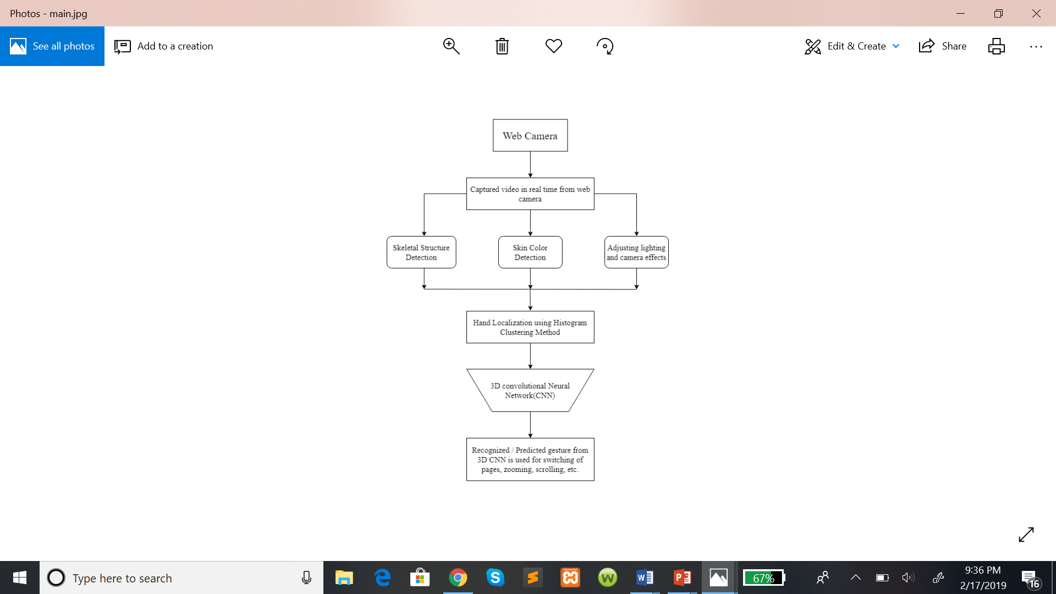
Overall design

Slide 6
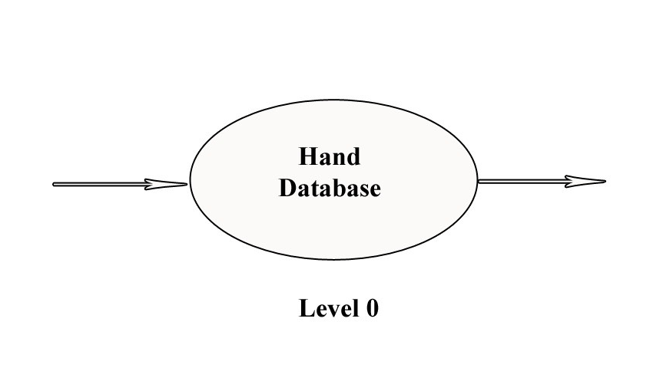
High level design analysis
Hand Movement
Action Performed

Slide 7
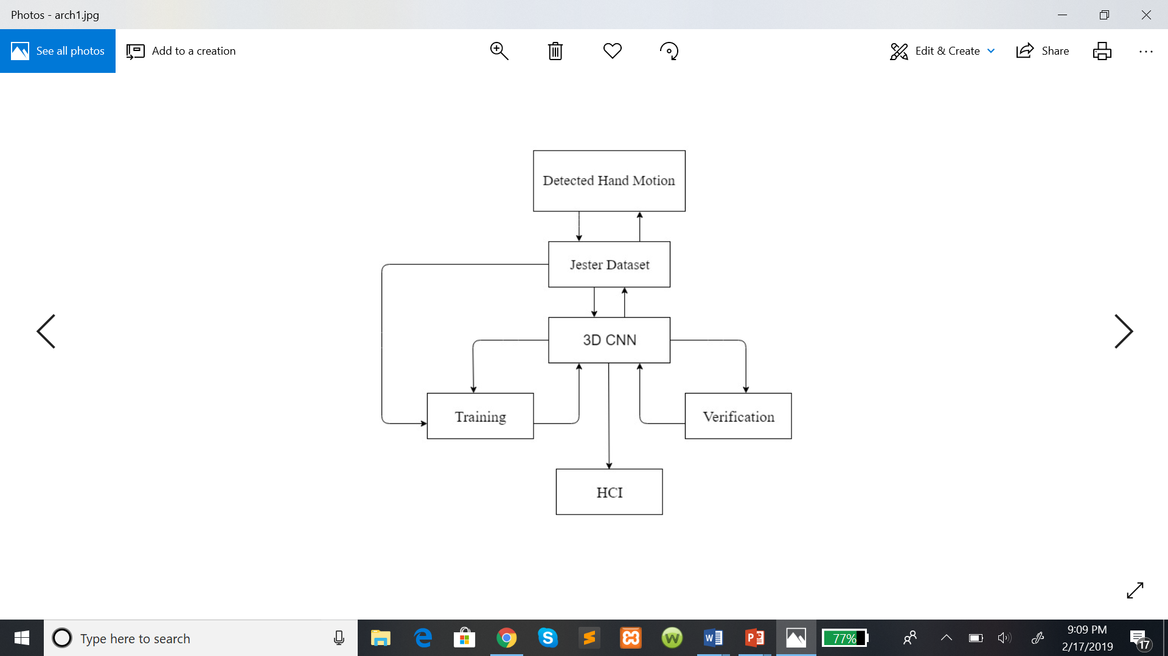
Architectural design

Slide 8
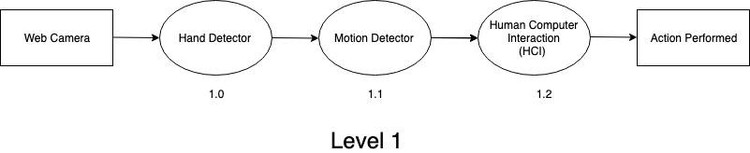

Slide 9
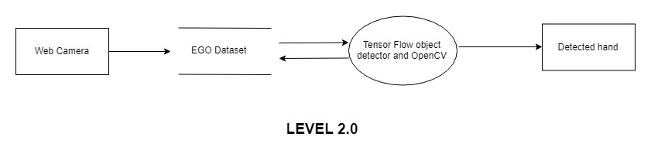
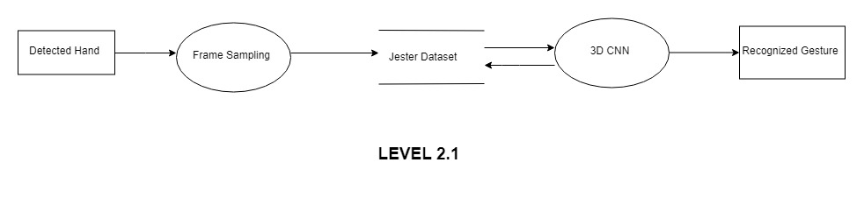
Component design

Slide 10

LEVEL 2.2

Slide 11
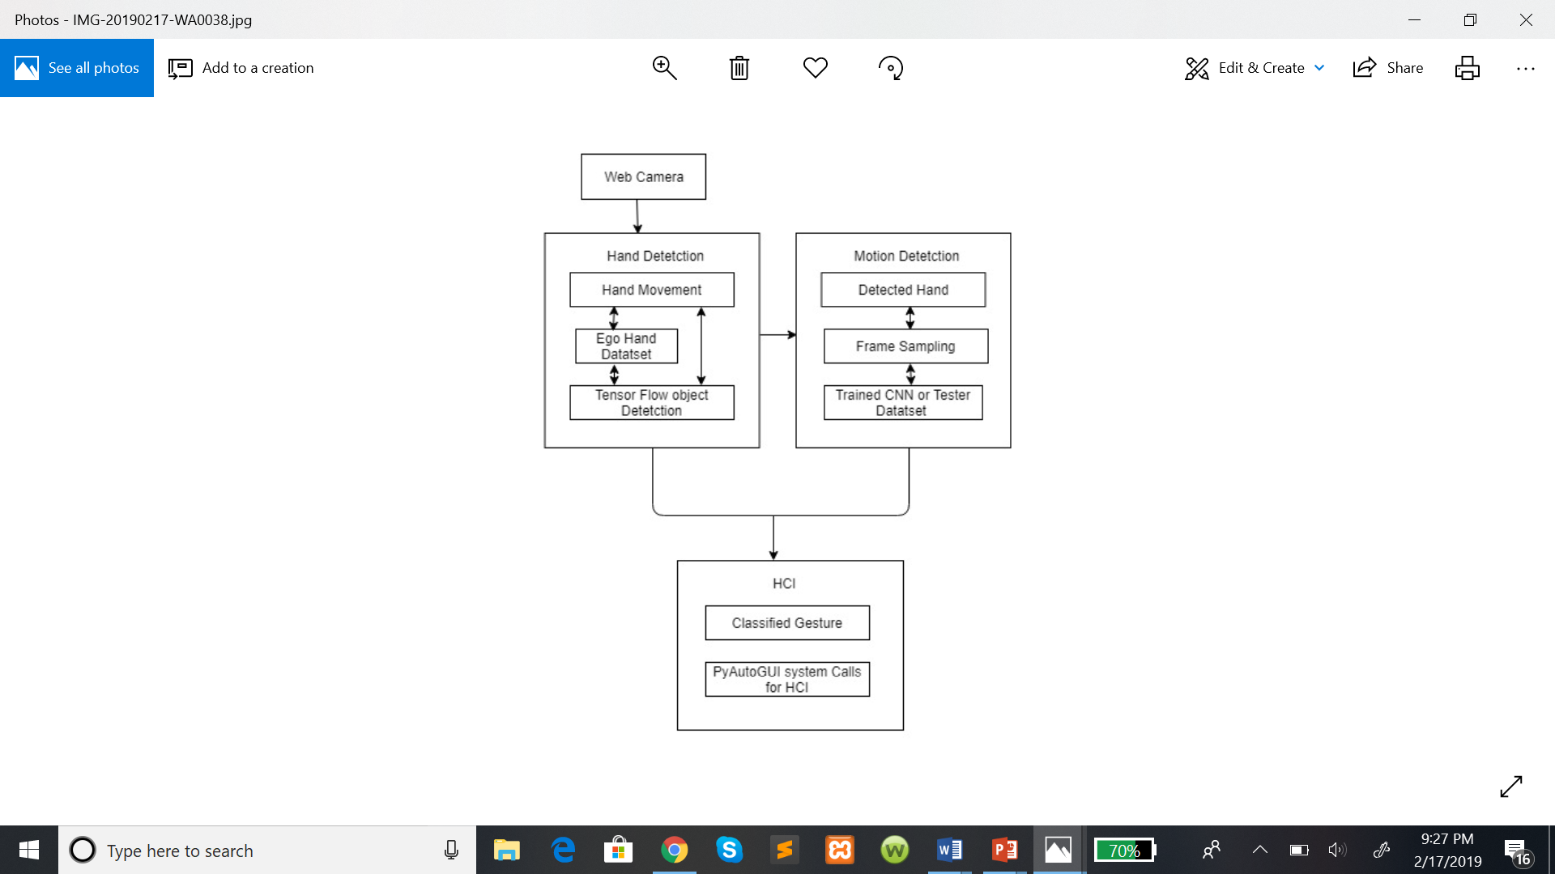

Slide 12
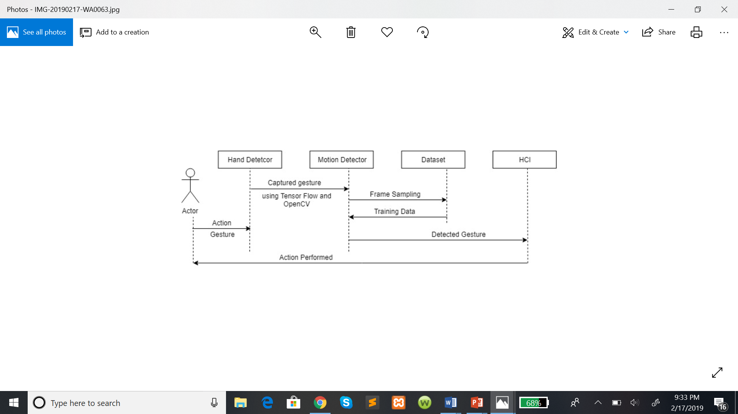
Behavioral design

Slide 13
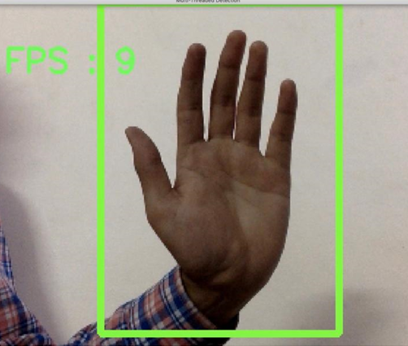
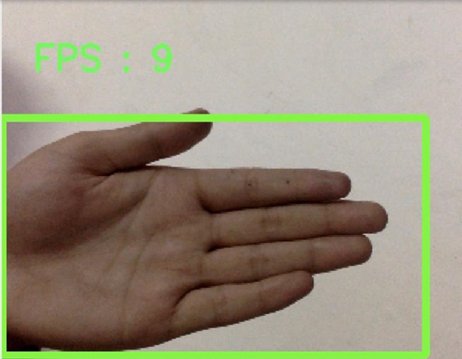
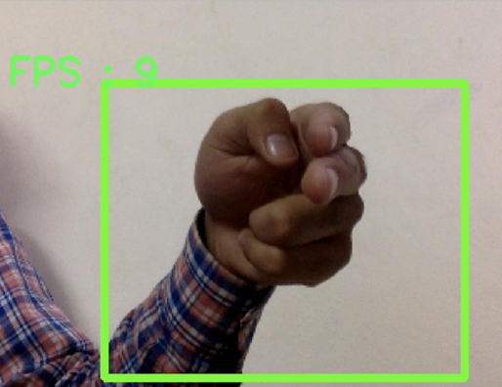
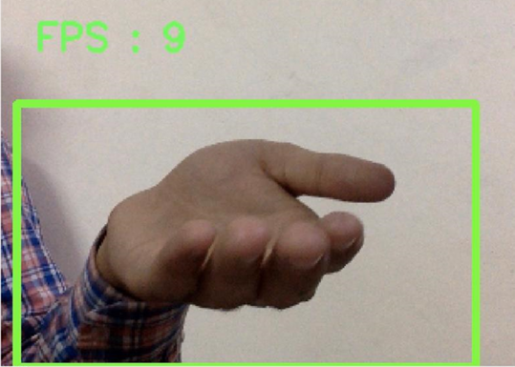
Experimentation and optimization : screenshots

Slide 14
Work in progress
Hand. Detection :
The system is able to detect the hand in the gesture obtained trough web camera using OpenCV and TensorFlow object detection.
It is trained on the EGO Hand dataset and is able to detect hands with an accuracy of 80%
Motion Detection :
The motion detection using frame sampling and training the CNN on the jester dataset is in progress.
3. Human Computer Interaction :
Once the motion detector is trained it will it interface with PDF / User Interface (UI) using PyAutoGUI (a python module to interact with user interfaces) or system calls to perform the recognized action.

Slide 15
Thank you

